Slide 1

King County, WA
Initial Analysis of Housing Pricing Data to Further Drive Predictive Models
Chaz Frazer

Slide 2
Housing Prices and correlation insights
King County, Washington continues to see significant wage growth as it leads the state in that category
We looked at recent housing pricing data to gain some initial analysis and insight based on a variety of factors, and present them here before we dive deeper into predictive analysis based on the metrics that performed the best
Building from these preliminary insights, we will use them to decide our next course of action; particularly in how we construct our predictive models for housing prices in the county
Note these insights are subject to change, but they give a good indicator on the various factors that may influence the future sale prices of homes in the county.

Slide 3
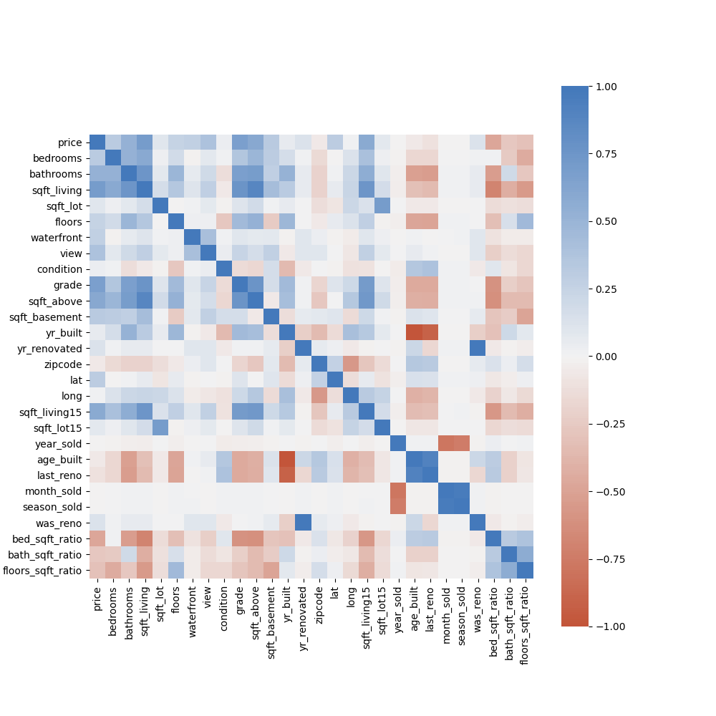
Correlation Heatmap
This correlation heatmap shows the relationship of various factors in our dataset to our price variable
Month and Season Sold do not seem to be highly correlated to price here much at all. Recent renovations don’t move the needle much, but there is a relationship to whether the home was renovated or not at all
This helps us solidify which features we should concentrate on looking at

Slide 4
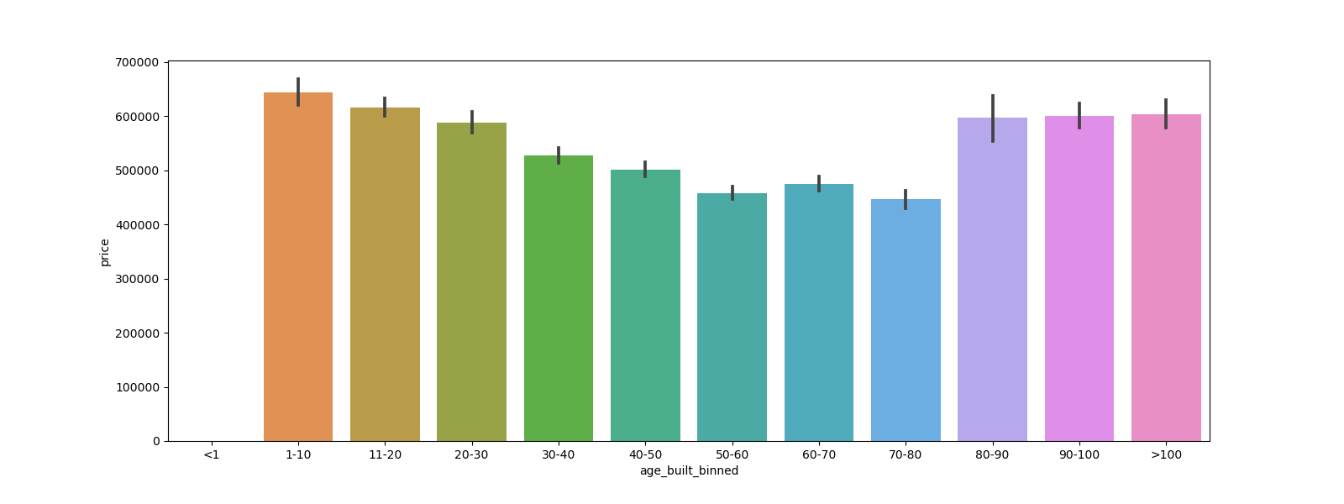
Homes Sold by Age
Examining the prices homes have sold for according to their age, shows younger homes and older homes selling for much higher prices than those in the past 30-70 years.
This may be to older homes’ build quality, vintage style and flair, or larger land plots. Younger homes may tend to have newer appliances, integrated technology (ie. smart homes), more outlandish architecture techniques, and resistance against regional natural disasters like earthquakes.

Slide 5
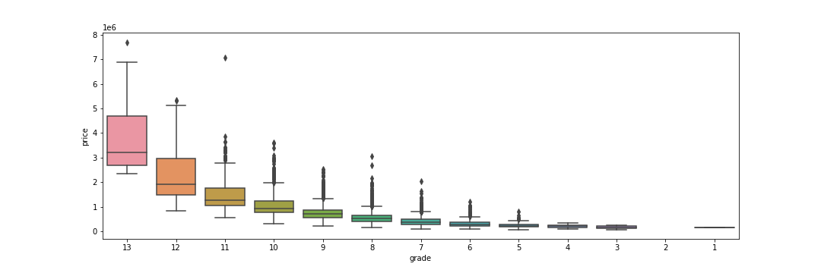
Grade of Homes vs Price
We can clearly see a distinct association between the grade of a property, vs the price it fetched. Initial OLS linear regression models show that the top 3 ratings boost the sale price of properties by an average of $106,000, while lower ratings can depreciate the sale values. ANOVA statistical tests also confirm these insights.
Key takeaways from this is to dive a bit deeper into the grading system, and potentially isolate the best grades from those that perform worse. There may be a relationship to the square footage of the home, number of beds/baths, condition, and other factors that are holding these homes back or making them undesirable

Slide 6
Conclusions
Classy, older homes and newer, recently built homes command the price market in terms of homes sold according to their age
Grade value of the homes are points in which buyers might take seriously and affect the price of the home significantly
Whether or not a home is renovated can increase the value of the home by around $20,000 based on initial linear regression models
Features to dive deeper into according to our statistical tests and early insights might help to drive our predictive models going forward

Slide 7

Thank you!

